Slide 1




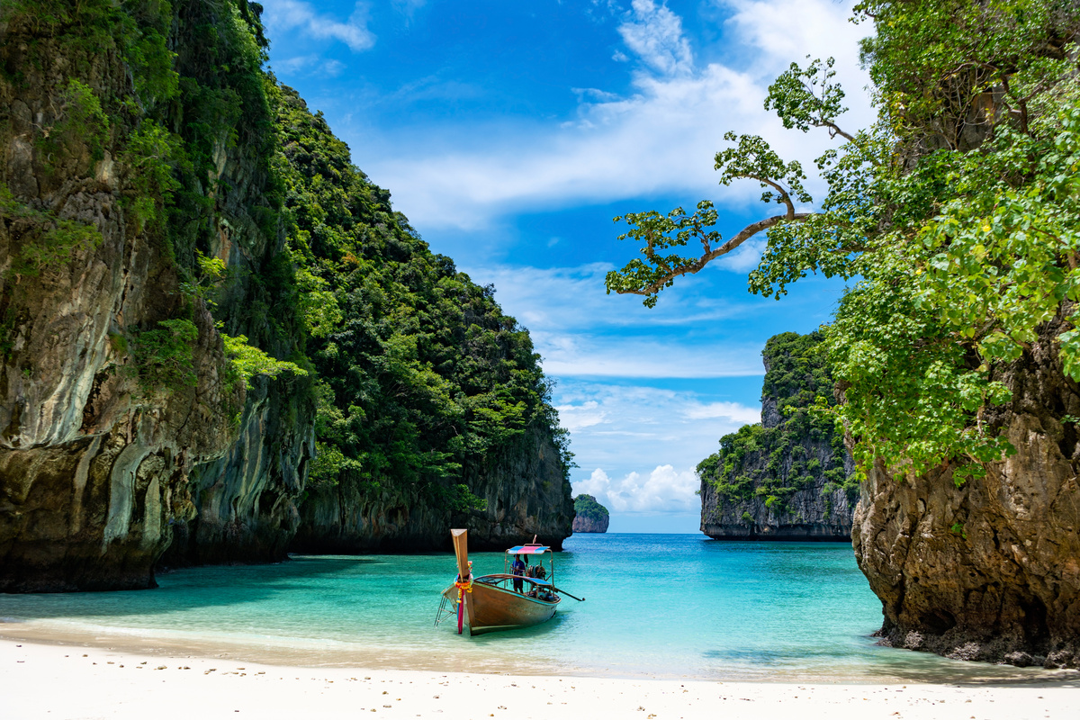





TOURIST EXPERIENCE
&
TRAVEL RISK INTELLIGENCE
SYSTEM
"Every journey has a story. We just learned to read it."
BIG DATA PRESENTATION
Satyaprakash Behera
24MBMB14
Business Analytics
School of Management Studies

Slide 2



&
PROJECT OVERVIEW
PROBLEM STATEMENT
Tourism experiences vary due to crowd, safety, weather, and cost.
Tourist reviews are mostly unstructured text and hard to evaluate manually.
Goal: Provide data-driven travel recommendations and insights.
Analyze city satisfaction, safety, seasons, and traveler preferences.

Slide 3



&
DATASET
DATA ARCHITECTURE
Dataset: tourist_experience_india.csv (1500+ records)
Bronze Layer: Raw data ingestion
Silver Layer: Cleaning, sentiment scoring, processing
Gold Layer: Final analytical tables for dashboards

Slide 4
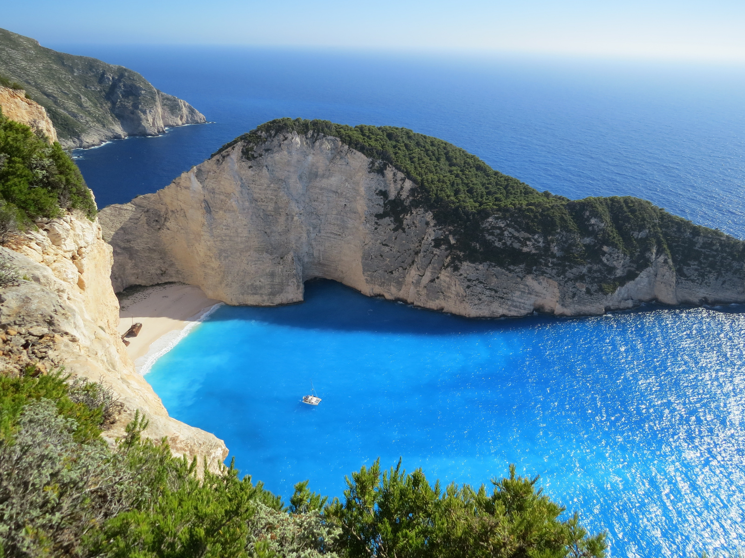

Hybrid Statistical + NLP Approach
VADER Sentiment Analysis for review emotion scoring
Experience Score Model (Rating + Sentiment)
Risk Score Model for safety classification
Traveler Segmentation based on preferences
&
MODELS
TECHNIQUES USED

Slide 5

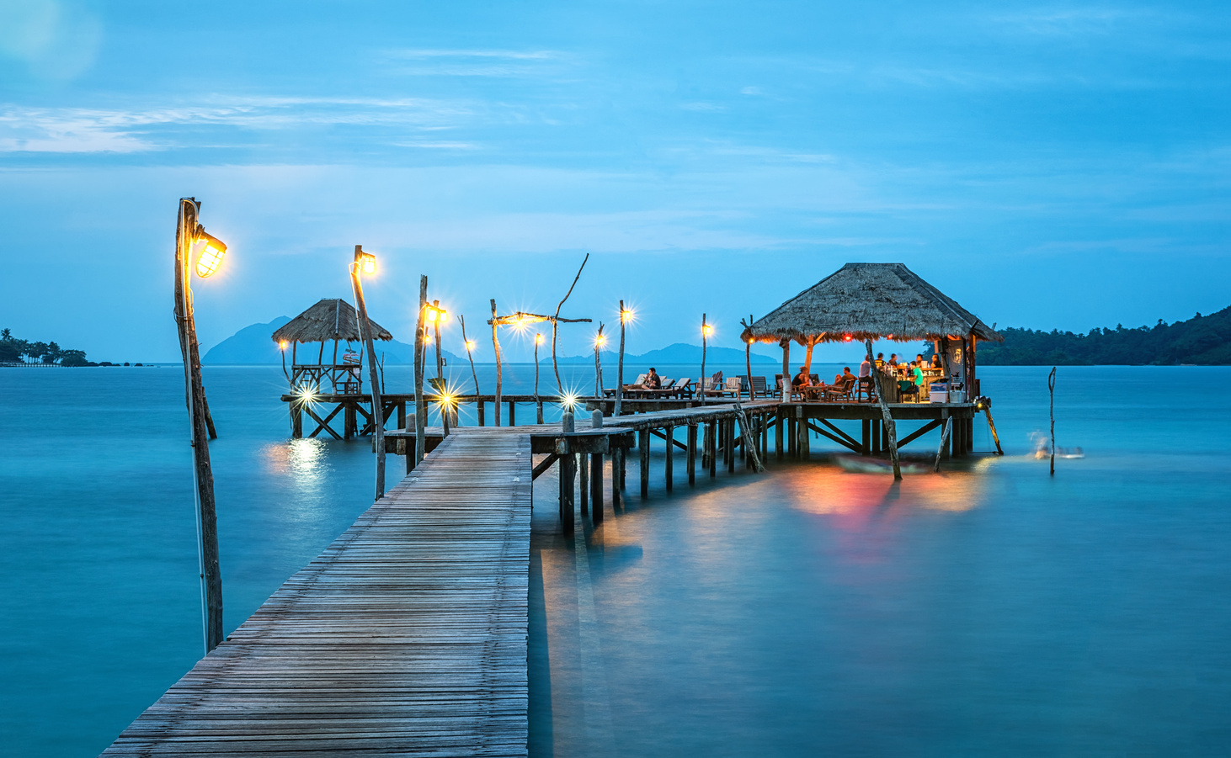

KEY INSIGHTS
Analysis Findings:
Hill stations and cultural heritage locations score highest in satisfaction.
Winter and post-monsoon are the best travel seasons.
Crowded metro destinations show higher negative sentiment.
Traveler preferences differ by Solo, Family, Couple, Friends groups.

Slide 6
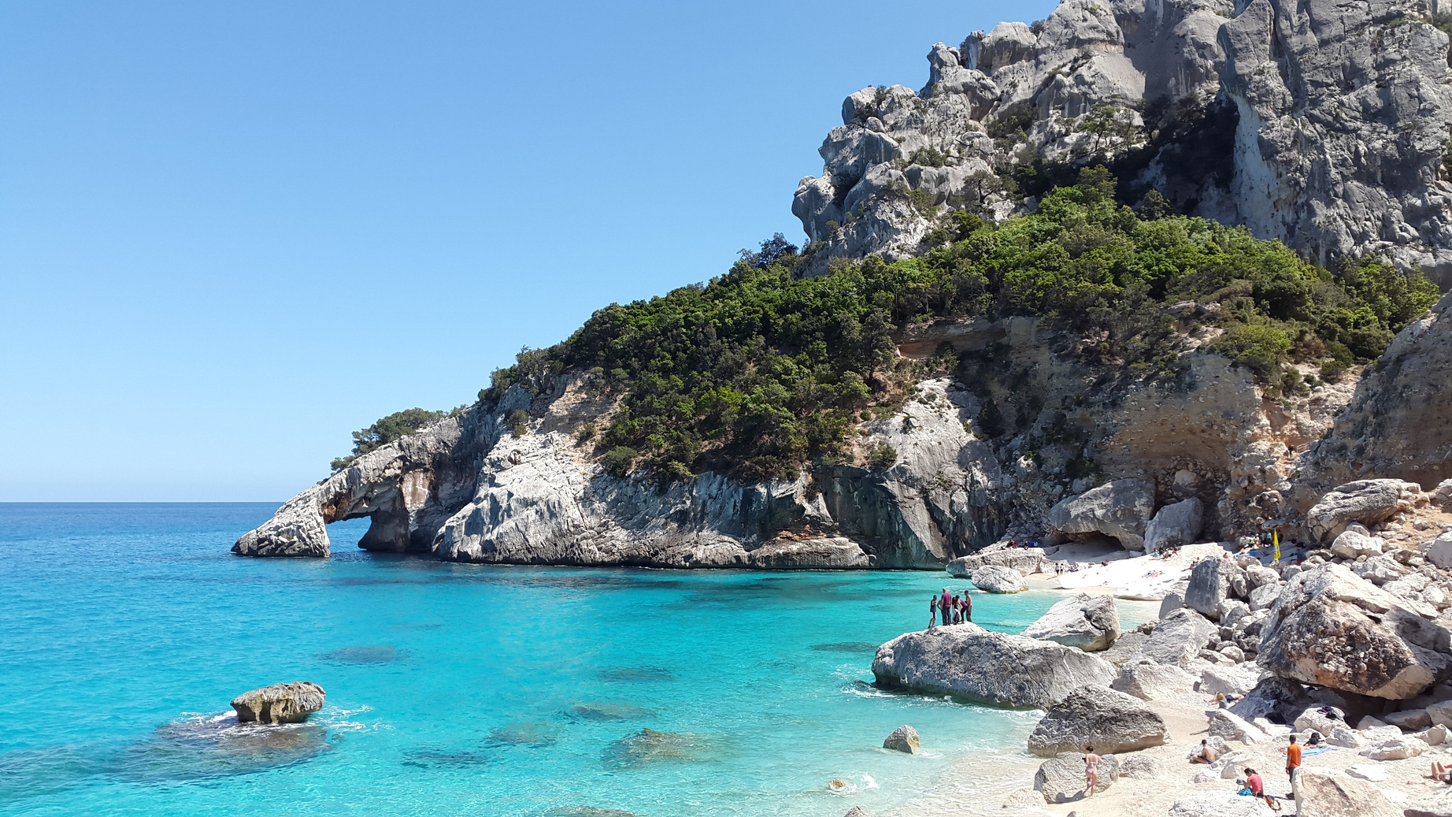
&
CONCLUSION
FUTURE SCOPE
CONCLUSION:
Big Data + NLP can effectively summarize large-scale tourist experiences.
Improves tourist planning and tourism development decisions.
FUTURE SCOPE:
Real-time crowd & safety alerts
Personalized trip planner mobile app
Integration with maps & travel booking platforms

Slide 7
THANK
You

